Slide 1
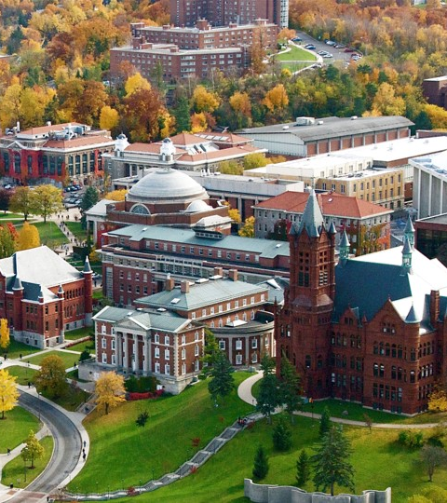
Portfolio Milestone Presentation4
Shashank Nagaraja
Master’s in Applied Data Science

Slide 2

Professional Experience
Shashank Nagaraja
Computational Biologist
3 Years of Experience in Biomedical Data Analytics (Next Generation Sequencing Data, Healthcare Analytics)
University of California, Los Angeles
B.S. in Molecular and Cell Developmental Biology (2014-2018)
Cedars Sinai Medical Centre, Los Angeles CA
Bioinformatics Research Associate (2018-2019)
Amgen, Thousand Oaks CA
Senior Associate Scientist, High Throughput Drug Formulation (2019-2021)

Slide 3
Master’s in Applied Data Science
The M.S. in Applied Data Science offered by Syracuse university is an interdisciplinary program that provides students the opportunity to learn a broad range of techniques in the field of Data Science. These techniques demonstrate value in understanding organizational needs, using creativity to solve unique problems, and brining innovative techniques from data analytics to improve how businesses operate.
Course Objectives:
Describe a broad overview of the major practice areas of data science.
Collect and organize data.
Identify patterns in data via visualization, statistical analysis, and data mining.
Develop alternative strategies based on the data.
Develop a plan of action to implement the business decisions derived from the analyses.
Demonstrate communication skills regarding data and its analysis for managers, IT professionals, programmers, statisticians, and other relevant professionals in their organization.
Synthesize the ethical dimensions of data science practice (e.g., privacy).

Slide 4
Learning Outcomes
Netflix
identify patterns using statistical techniques and visualization
Fashion MNIST
develop different strategies based on the data story
Political Party Classifier
collect & organize data
develop different strategies based on the data story
extract insight and construct a business strategy
communicate findings to relevant stakeholders
consider the ethical implications of data collection and model use
consider the ethical implications of data collection and model use
collect & organize data
collect & organize data
develop a plan of action to implement business decisions
demonstrate communication skills

Slide 5
Project 1: Netflix
Identifying business strategies used by Netflix using Visualization Techniques

Slide 6
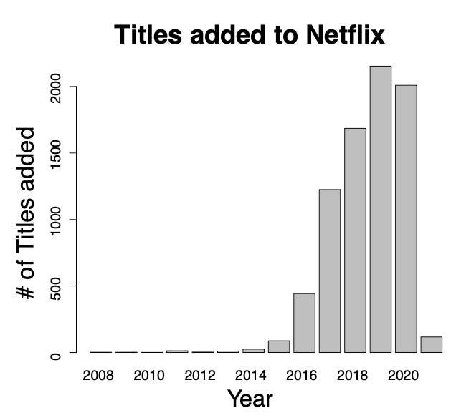
Project 1: Netflix
Netflix API provides access to all available titles
Data includes:
Movie/TV Show Name
MPAA Rating
Description
Release Year
Year Added to Netflix library
Genre
Yearly aggregate shows sharp increase of titles added to the Netflix platform upto 2020. Netflix was not on track to equal their 2020 performance in 2021.

Slide 7
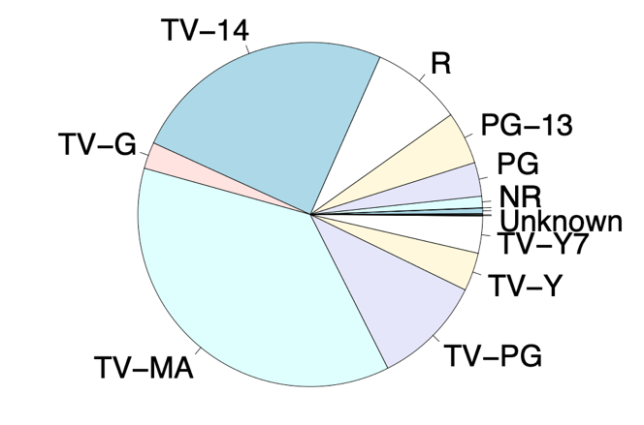
Project 1: Netflix
Netflix shows a preference for content geared towards adults and older teenagers.
Sizable of content rated ‘R’ – heavy focus on Adult and Young Adult content.
Some movies have an unknown MPAA rating; on closer inspection these movies are only available in countries outside the USA and have hence not been rated by the Motion Picture Association of America.
Unlike its counterpart Disney+, Netflix focuses on content for adult and teenage viewers with a small selection of children’s titles

Slide 8
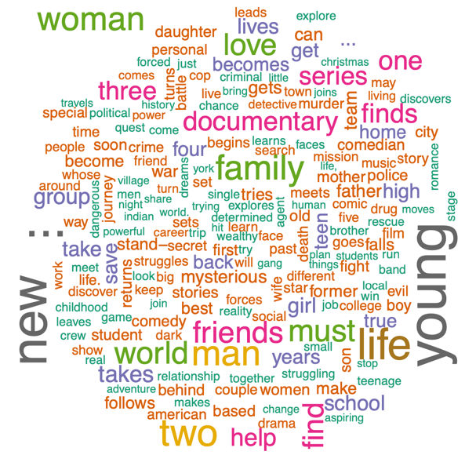
Project 1: Netflix
Wordcloud of titles available on Netflix, using description text that is shown to users along with the trailer.
In order to better understand the differences by genre, each genre has been color coded.
For example, we see that Action and Adventure movies use words like “power”, “war”, “struggle” and “mysterious” while Family movies use words like “love” and “world” to draw their viewers in.

Slide 9
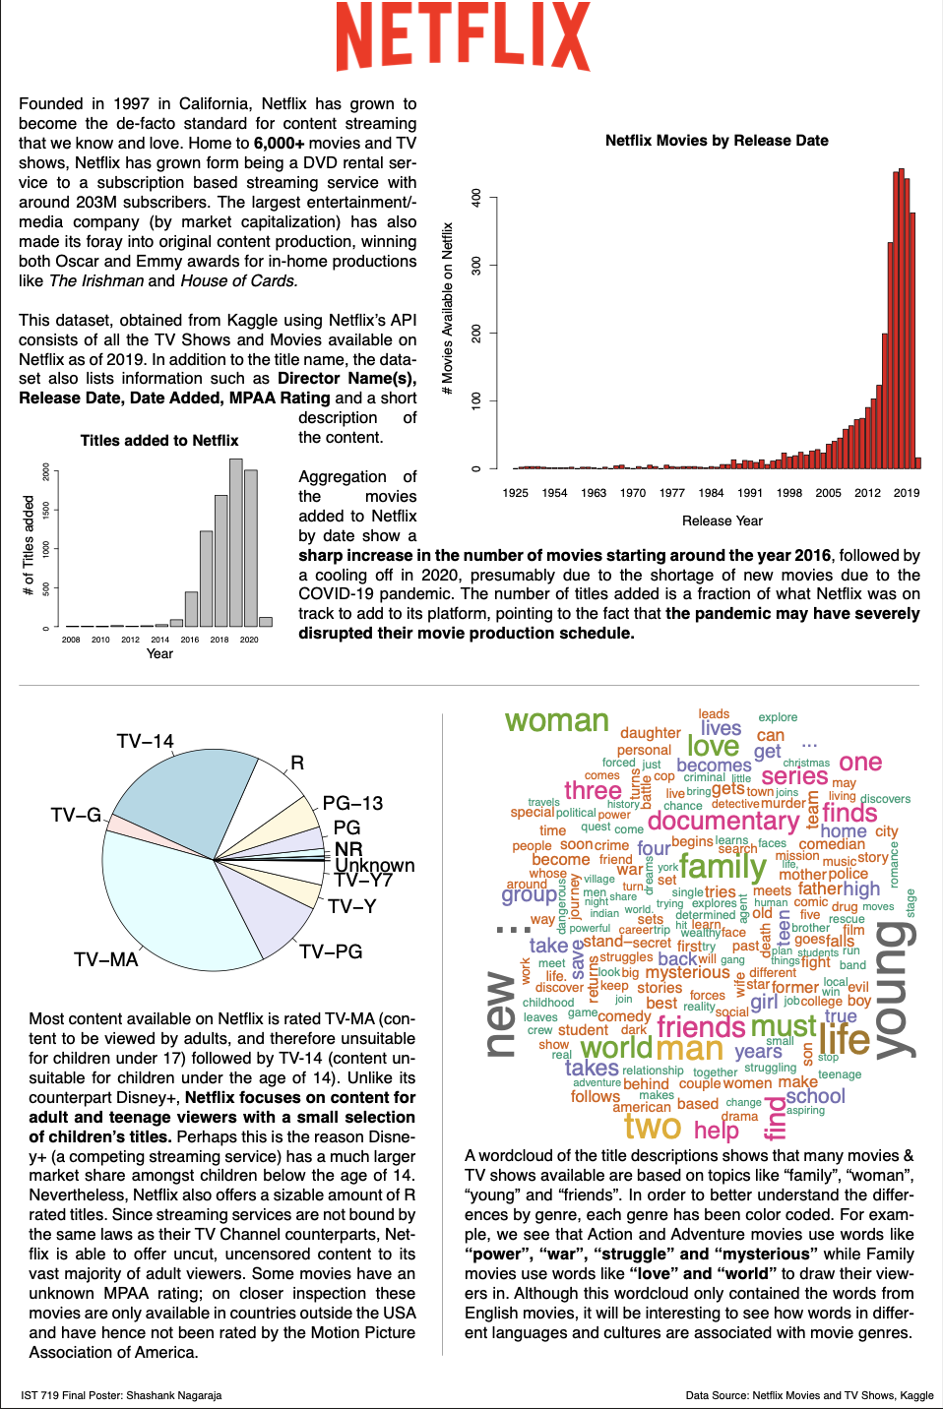
Project 1: Netflix
Cannot limit data storytelling to ineffective plots which do not capture the audience's attention
Need to construct effective data visualizations meant to interact with and encourage the viewer to explore the data themselves and come to their own conclusions.

Slide 10
Project 2: Fashion MNIST
Exploring a complex dataset for benchmarking Classification Algorithms

Slide 11
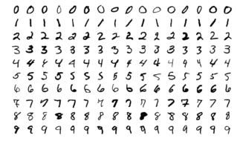
Project 2: Fashion MNIST
MNIST is commonly used in the field of training image classification systems in Machine Learning. MNIST is a repository of 28X28 images of handwritten digits (numerals 0-9).
Primarily serves as a benchmark dataset against which multiple models are trained and evaluated.
With increasing access to model-building frameworks (sklearn, tensorflow, etc.) and computational power, the MNIST dataset has been criticized for not being complex enough.

Slide 12
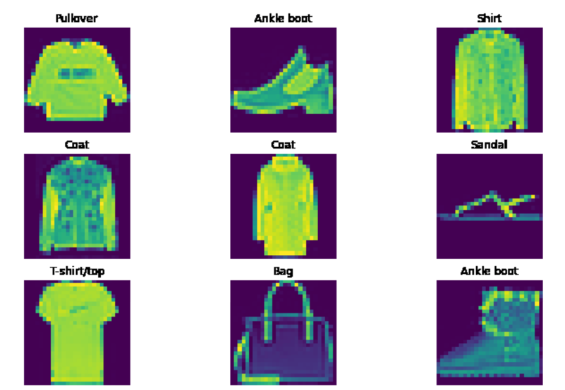
Project 2:Fashion MNIST
Fashion MNIST contains a training set of 60,000 images and a test set of 10,000 images obtained from the German fashion retailer Zalando.
Accurately represents the complexity of modern Computer Vision tasks.
Drop-in replacement for MNIST (same image size and train/test split

Slide 13
Project 2: Fashion MNIST
Keras
Training Data
Reshape
Hyperparameter Optimization through RandomizedSearchCV
KNN Classifier
KNN Classifier
KNN Classifier
KNN Classifier
Naïve Bayes Classifier

Slide 14
Project 2: Fashion MNIST
Predictions
Keras
Reshape
Accuracy
F-score
Precision
Recall
Test Data
Naïve Bayes Classifier

Slide 15
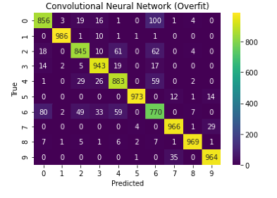
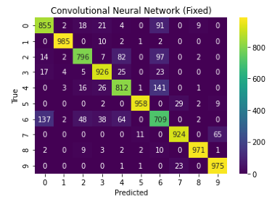
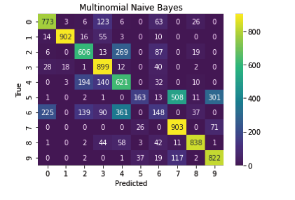
Project 2: Fashion MNIST
Keras Model has the highest accuracy (~ 90%)
Confusion in classifying “T-shirt/top”, “Shirt”, and “Coat” classes

Slide 16
Project 3: Political Party Classifier
Predict party affiliation from model trained on tweets made by US politicians

Slide 17
Project 3: Political Party Classifier
Complex socio-political conundrums like abortion, the COVID-19 pandemic and President Trump’s election are hot topics of discussion, further amplified by social media like Twitter and Facebook.
Politicians themselves have realized the benefits of pandering to their niche voter base – using their social media platforms to increase their reach amongst voters.
Therefore, it is increasingly valuable to be able to classify tweet content in order to find potential leads and target audiences.

Slide 18
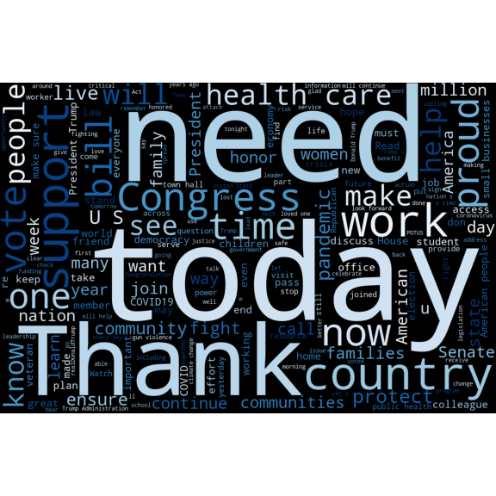
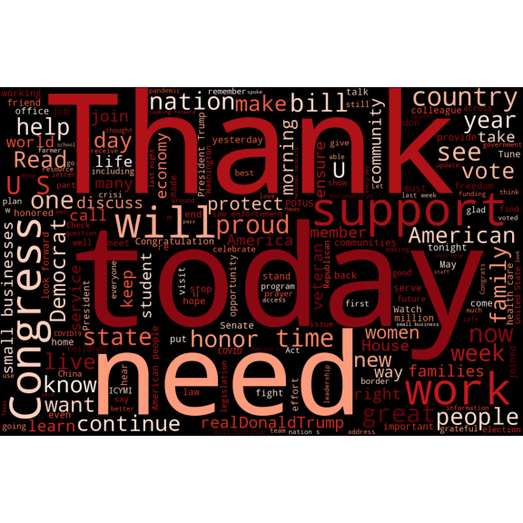
Project 3: Political Party Classifier
Democrat
The TWINT API allowed the entire post history of each account to be harvested from just the twitter handle.
The true label of each of the tweets was assumed to be the political party affiliation of the politician that posted them.
Republican

Slide 19
Project 3: Political Party Classifier
All models were evaluated using 5-fold cross validation.
True Positive Rate (TPR), False Positive Rate (FPR), F1-Score and Model Accuracy were collected from each fold and averaged across runs to evaluate long-run model performance.

Slide 20
Project 3: Political Party Classifier
Through this analysis, a large amount of publicly available text data was collected using an API and organized into two class labels. Various models were trained using the k-fold cross validation technique, and model performance was evaluated using various classification metrics. The models were saved in order to be deployed later.
By using object-oriented programming (to customize of-the-shelf models), robust application structure (pipeline construction) and version control (using git), the pillars of data science software development learned during previous courses were put into practice.

Slide 21
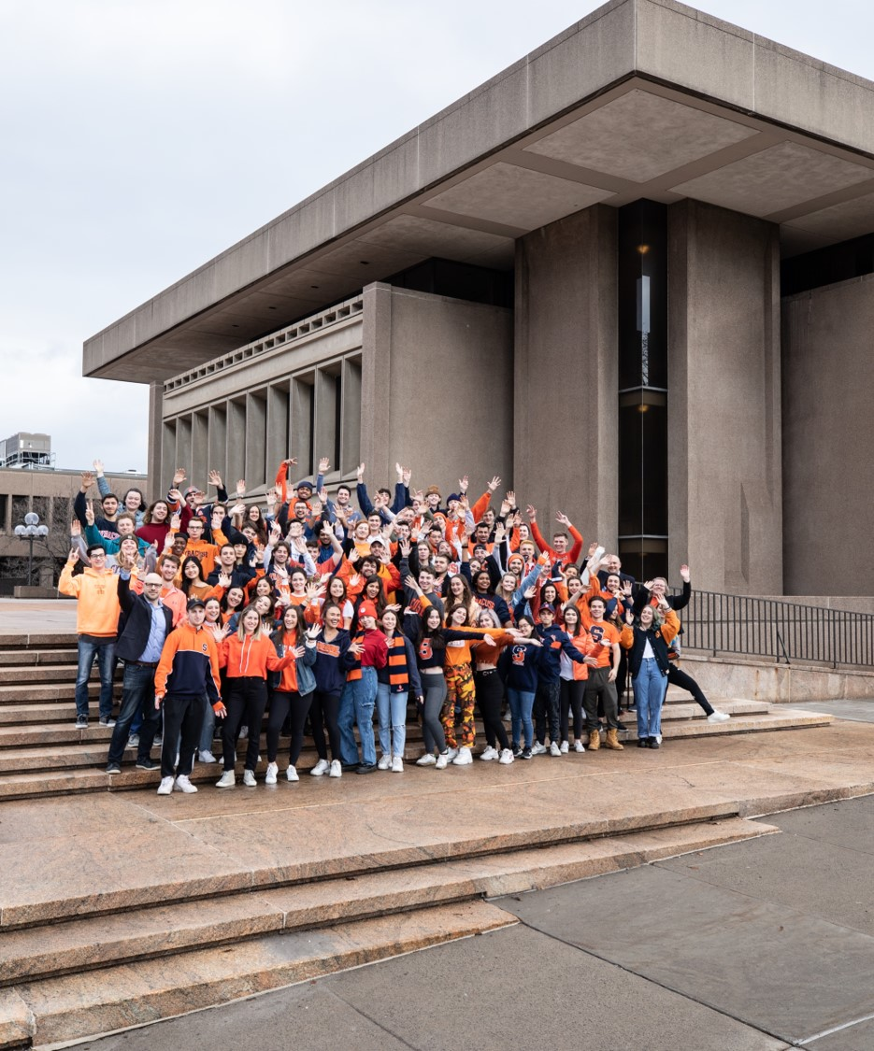
Conclusion
Fulfillment of learning outcomes

Slide 22
Conclusion
By completing projects in the sub-fields of Data Visualization, Natural language Processing, Text Mining, Statistics and Neural Networks, I have had the chance to prove that I have the tools to further my journey on the path of data science practice.
By extracting insight from data, I am confident that the role of the data scientist will become even more important in the years to come.

Slide 23
Questions? Comments?
Shashank Nagaraja
P: +1 (972) 974-8197
E: snagaraj@syr.edu
https://github.com/dapluggg/Syracuse-MS-ADS-Portfolio-Milestone.git

